Slide 1
Unity teamwork game

Slide 2
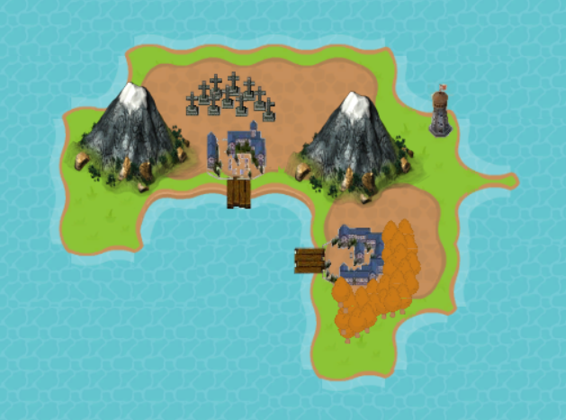
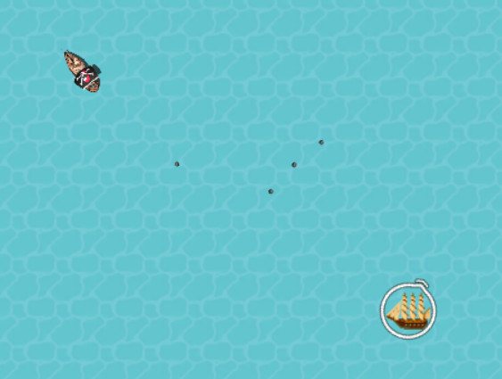
What is the game?

Slide 3

Hunt pirates
Level up your ship
Do various quests
Find the pirate map
Try not to die

Slide 4
Sprites used
http://opengameart.org/content/black-sail-ship-bleeds-game-art
http://kenney.nl/assets/rpg-base
http://spritedatabase.net/file/6987
http://opengameart.org/content/natural-resource-deposits-and-mines-unknown-horizons-2d
http://opengameart.org/content/lpc-hanging-signs
http://opengameart.org/content/outdatedarchive-fantasy-icon-pack
http://opengameart.org/content/bevouliin-free-beach-game-background-for-game-developers
http://opengameart.org/content/potion-0
http://opengameart.org/content/burnt-scroll

Slide 5
Sounds used 1/2
https://www.freesound.org/people/Northern%20Rebel/sounds/54959/
https://www.freesound.org/people/kanalgas/sounds/250317/
https://www.freesound.org/people/pawsound/sounds/154881/
https://www.freesound.org/people/Kastenfrosch/sounds/162455/
https://www.freesound.org/people/Cyberkineticfilms/sounds/127845/
https://www.freesound.org/people/klangfabrik/sounds/210613/
https://www.freesound.org/people/isteak/sounds/263786/
https://www.freesound.org/people/Snapper4298/sounds/166703/
https://www.freesound.org/people/qubodup/sounds/212143/
https://www.freesound.org/people/Bird_man/sounds/316744/
https://www.freesound.org/people/kevinkace/sounds/66778/

Slide 6
Sounds used 2/2
https://www.freesound.org/people/Kodack/sounds/257752/
https://www.freesound.org/people/mickleness/sounds/269190/
https://www.freesound.org/people/mickleness/sounds/269198/
https://www.freesound.org/people/BettinaMasberg/sounds/194193/
https://www.freesound.org/people/rockdoctor/sounds/38017/
https://www.freesound.org/people/qubodup/sounds/332056/
http://opengameart.org/content/water-waves
http://opengameart.org/content/beach-ocean-waves
http://opengameart.org/content/water-splashes
http://www.incompetech.com/music/royalty-free/index.html?isrc=USUAN1100594&Search=Search
http://incompetech.com/music/royalty-free/index.html?keywords=medieval&Search=Search

Slide 7
Hope you like the game.

